Slide 1

Supervised Machine Learning Bot Detection Technique to Identify Twitter Bots
Group 1 Monday Batch
Team Members
Atulya Sharma
Samruddhi Pasari
Vivek Koli

Slide 2
INTRODUCTION
In this project, we compare the accuracy of several bot-versus-human classification models and investigate the effect of dimensionality reduction on model accuracy.
Social media can be used to disseminate false information and mislead.
While many bots have benign functions, bots on social media platforms have increasingly been implicated in influencing political opinion, spreading conspiracy theories and manipulating the stock market.

Slide 3
APPROACH
The primary objective of this project is to apply machine learning algorithms like Logistic Regression, Random Forest and Support Vector Machine (SVM) to distinguish bots from humans.
To prepare the dataset that can be read by the algorithm followed by building the machine learning model and checking the accuracy and then finally running the model on a new dataset to verify if the tweet is done by a bot or by a human.

Slide 4
DATA CLEANING PROCESS
Preprocessing involves removal or certain columns, handling missing values by replacing them with ‘0’ and removing rows that are not very useful.
We had multiple datasets, we had to merge and concatenate them into one final dataset which is then normalized so that all the rows have values that lie between 0 and 1
In Order to make the dataset compatible with the machine learning algorithms, we had to change certain columns from one data type to another.

Slide 5
COLUMN DESCRIPTION
Following are the columns with description after data cleaning:
acct_age: the age of the twitter account after it was created
favourites_count: the number of tweets favorited by the account user
followers_count: the count of the accounts that follow the user
following: the count of accounts followed by the user
friends_count: number of friends of this user
id: unique id of the user
num_hashtags: number of hashtags in the particular tweet
num_mentions: number of accounts mentioned in the particular tweet
num_urls: number of urls added in the particular tweet
retweet_count: number of tweets retweeted by the user
statuses_count: number of statuses posted by the user
user_type: Type of user (0 for Bot and 1 for Human)
verified: Whether the user account has been verified

Slide 6
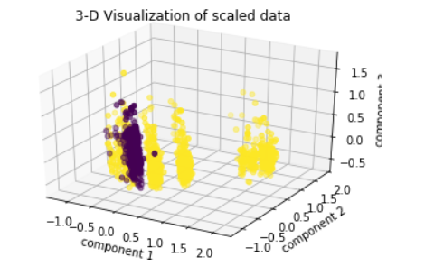
VISUALIZATION
3-D Visualization of scaled dataset

Slide 7
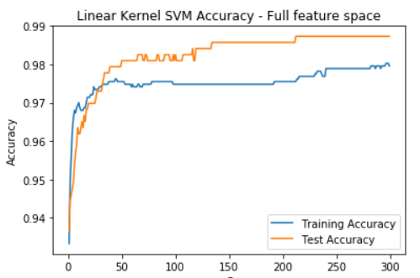
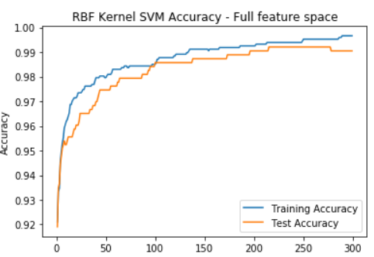
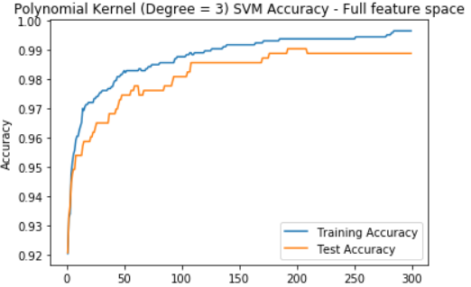
VISUALIZATION/GRAPHS
SVM model Accuracy vs C graphs for Linear, RBF, Polynomial kernel with full features

Slide 8
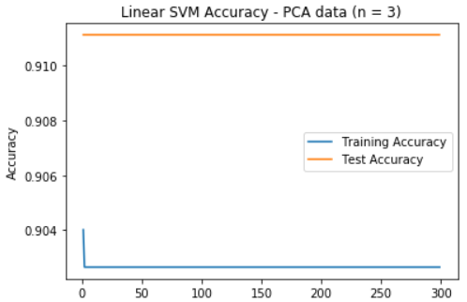
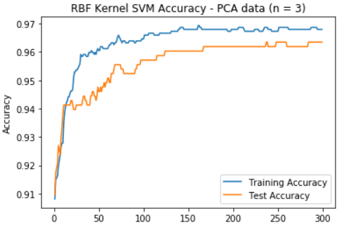
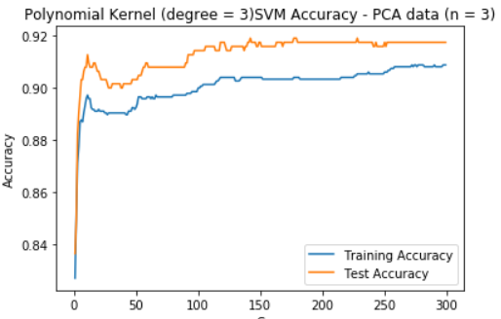
VISUALIZATION/GRAPHS
SVM model Accuracy vs C graphs for Linear, RBF, Polynomial kernel with PCA data for n = 3

Slide 9
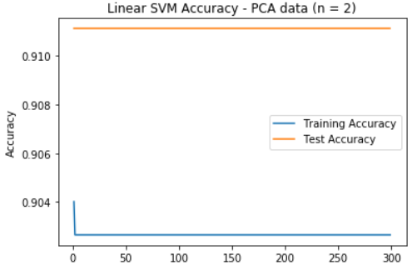
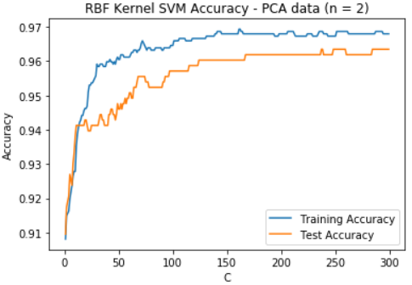
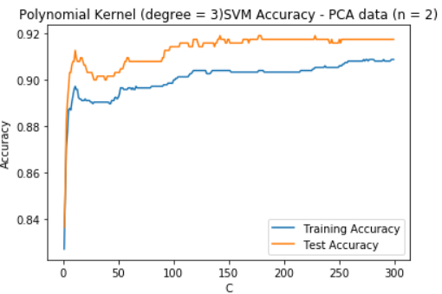
VISUALIZATION/GRAPHS
SVM model Accuracy vs C graphs for Linear, RBF, Polynomial kernel with PCA data for n = 2

Slide 10
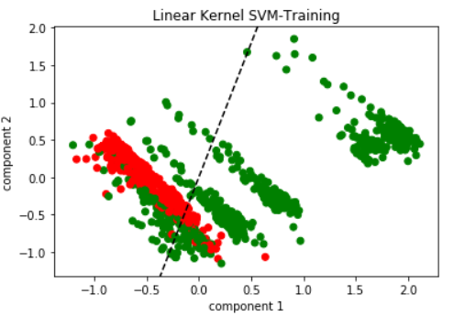
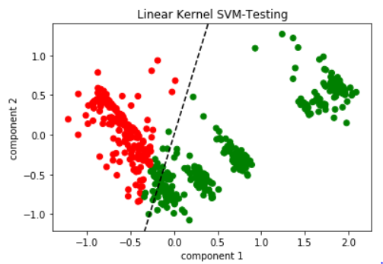
VISUALIZATION/GRAPHS
SVM model graphs for Linear kernel training and test data with PCA for n = 2

Slide 11
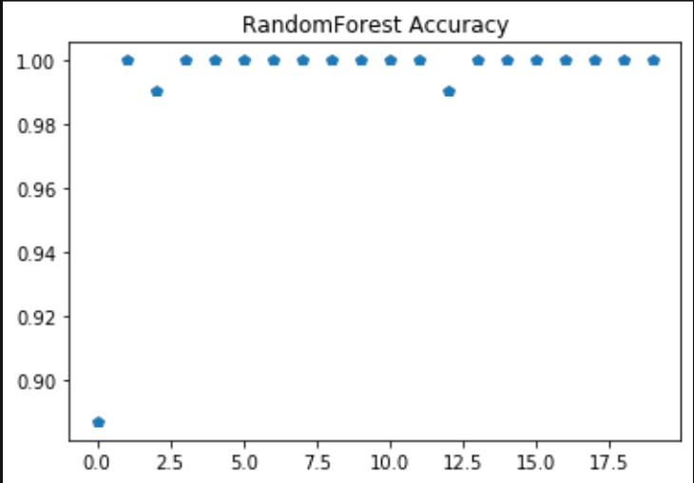
VISUALIZATIONS/GRAPHS

Slide 12
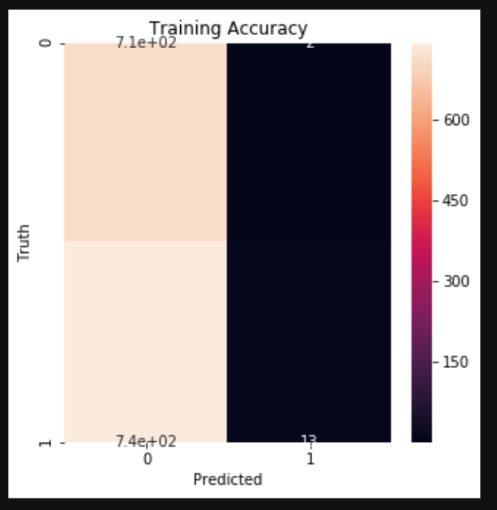
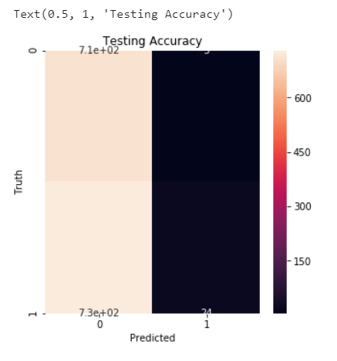
VISUALIZATION/GRAPHS
Visualization of confusion matrix along with the plot of accuracies for the feature matrix for Random Forest

Slide 13
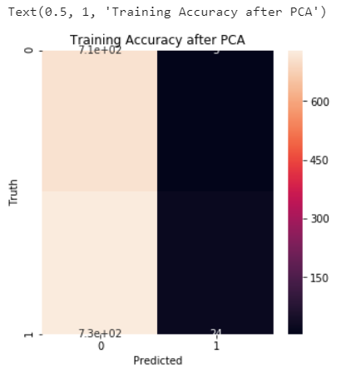
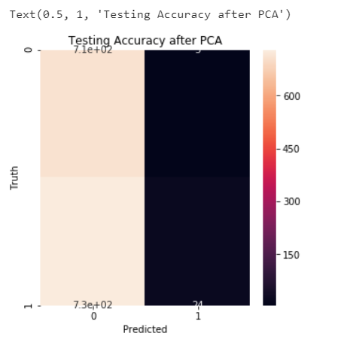
VISUALIZATION/GRAPHS

Slide 14
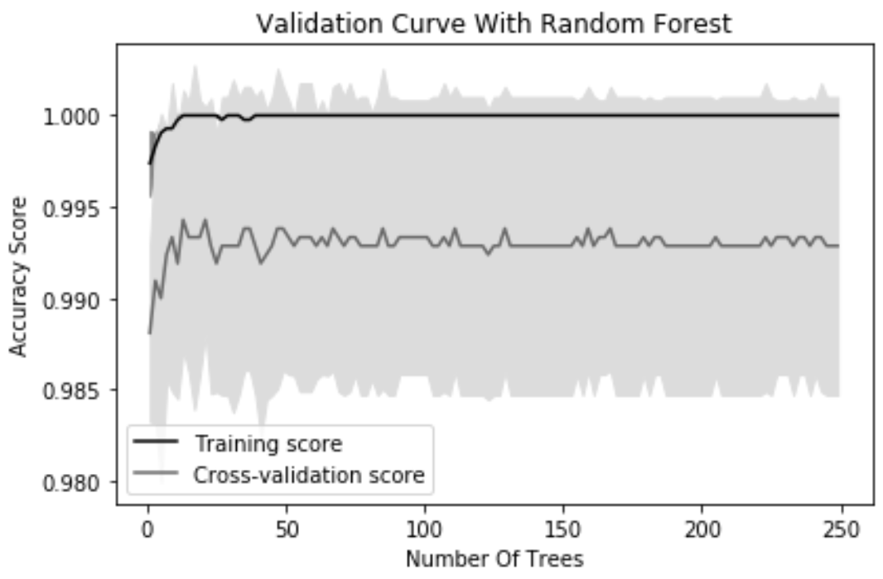
VISUALIZATION/GRAPHS

Slide 15
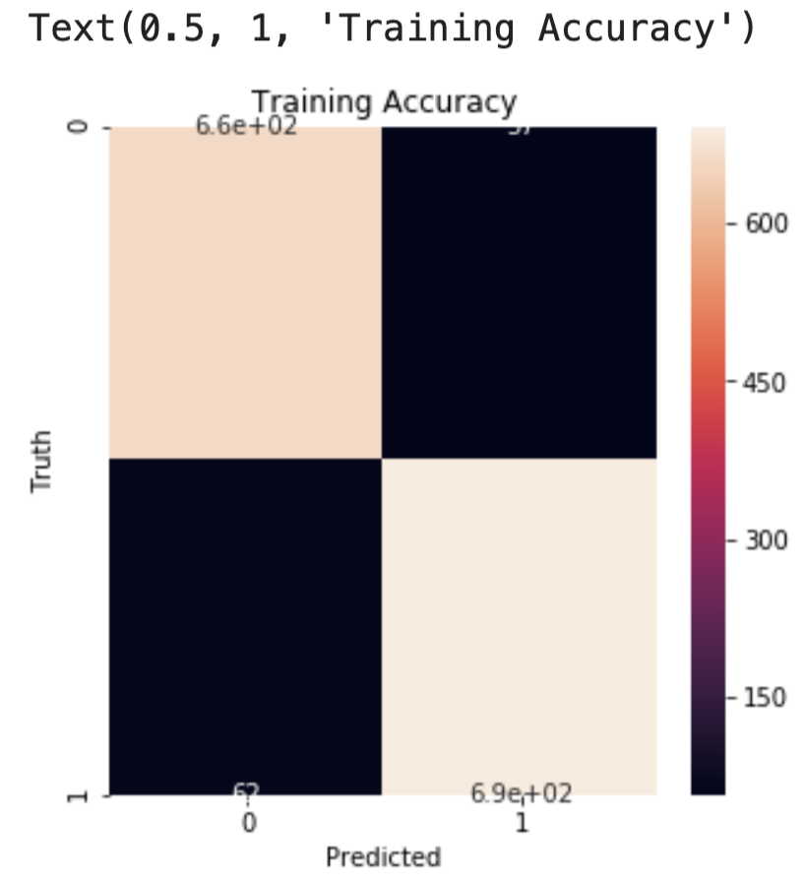
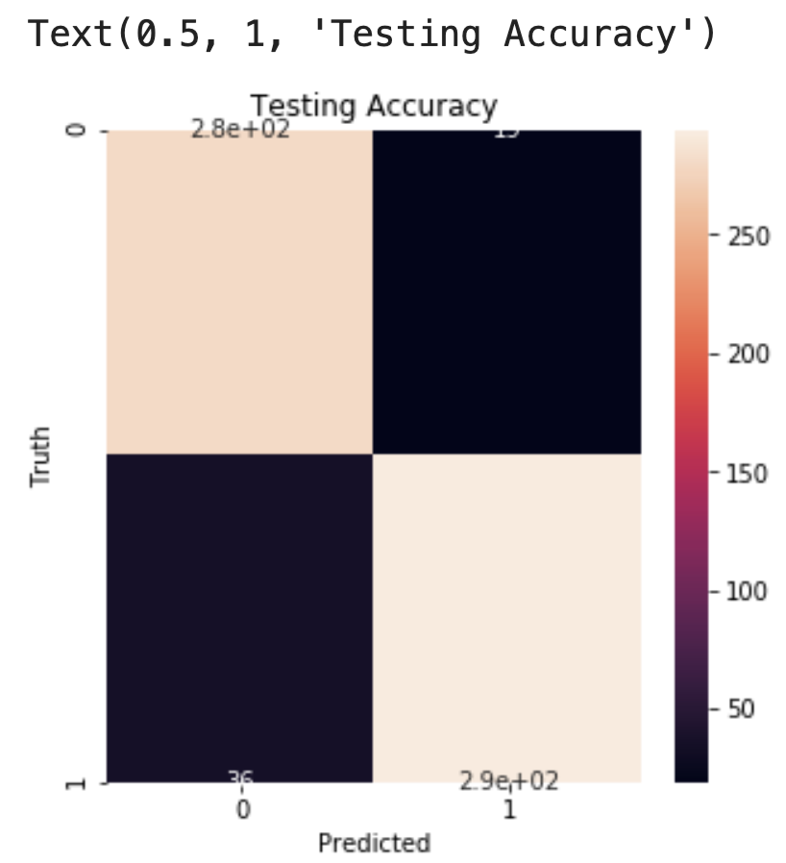
VISUALIZATION/GRAPHS
Visualization of confusion matrix along with the plot of accuracies for the feature matrix for Logistic Regression

Slide 16
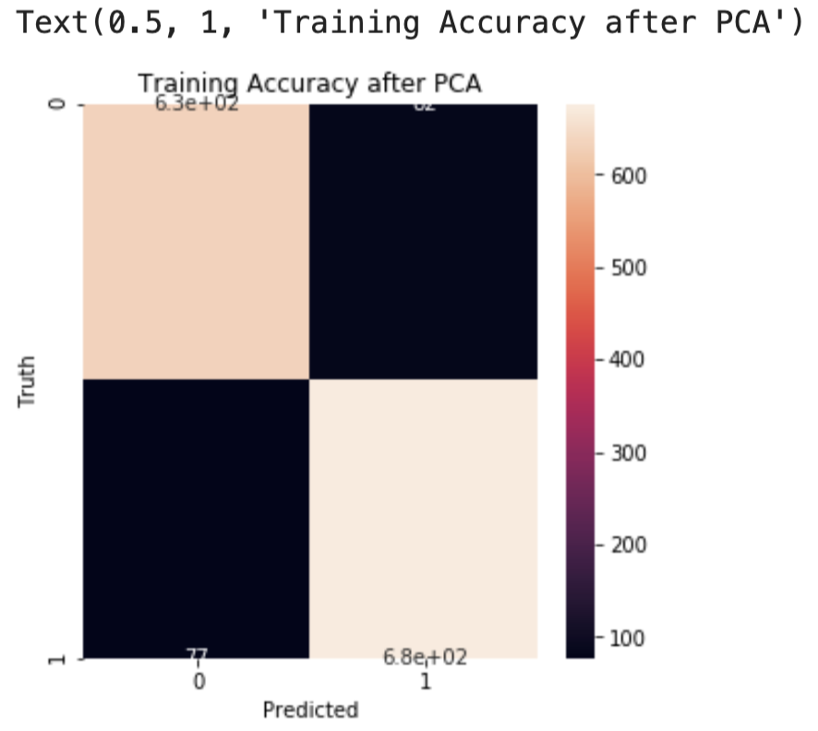
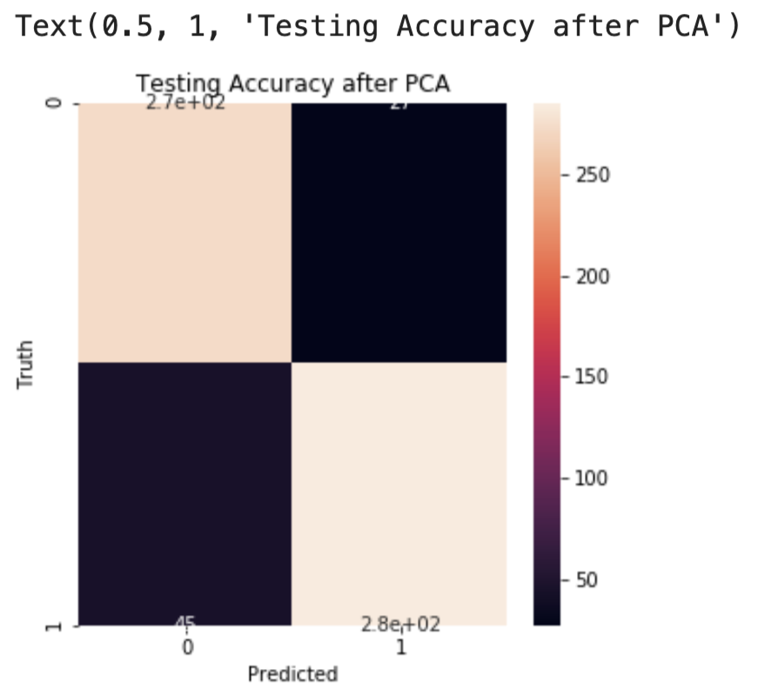
VISUALIZATION/GRAPHS
Visualization of confusion matrix along with the plot of accuracies for the feature matrix for Logistic Regression after PCA

Slide 17
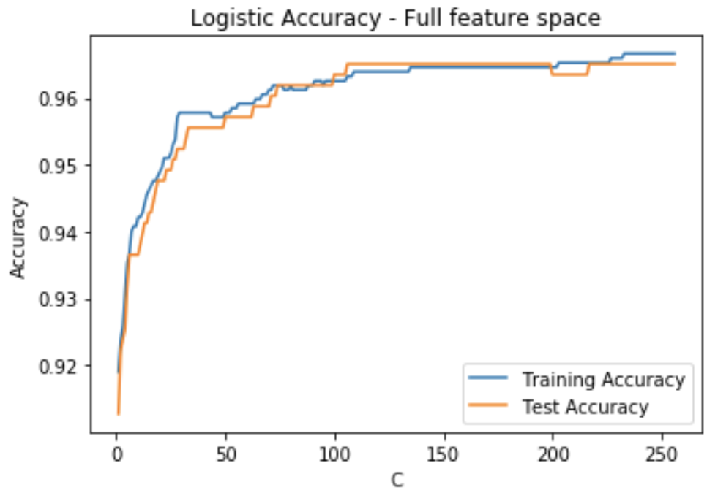
VISUALIZATION/GRAPHS
Logistic Regression Accuracy vs C plot

Slide 18
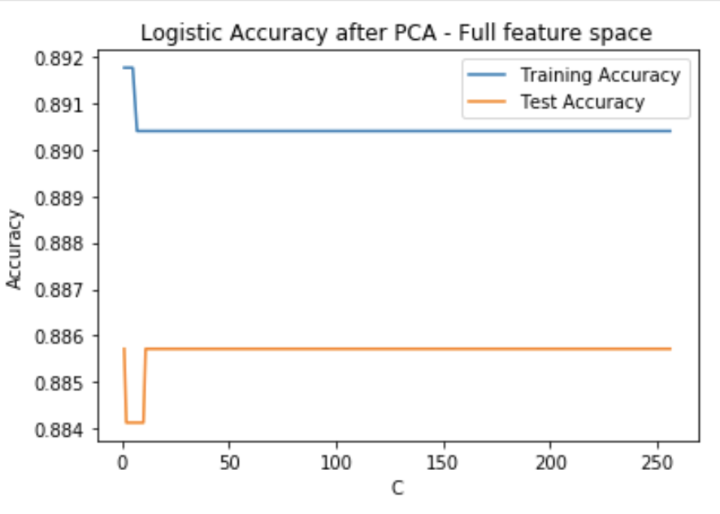
VISUALIZATION/GRAPHS
Logistic Regression Accuracy vs C plot after PCA

Slide 19
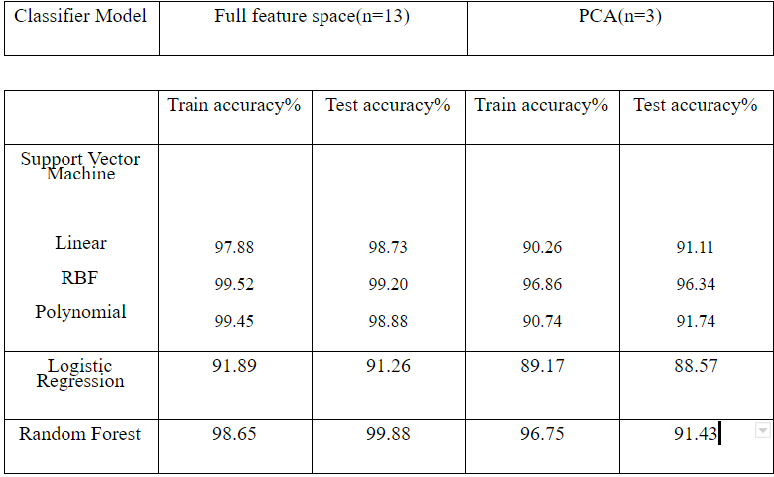
RESULT
Accuracy comparison for all three models

Slide 20
Conclusion
The most accurate machine learning model is SVM with RBF kernel, with the training accuracy of 96.34% after PCA.
The general observation after implementing PCA is that the accuracy of the prediction reduces with just a few exceptions.

Slide 21
ACCOMPLISHMENT STATEMENT
The ruleset that we have proposed works best against bots that are the fake follower type.
This can be improved even further by adding more variables about users activity patterns and the contents of the tweets.
A large dataset is required to adequately analyze the tweets.

Slide 22
FUTURE SCOPE
The models can be performed on a larger dataset with more supervised machine learning algorithms like Naive Bayes.
Different Parameter tuning/ preprocessing can be done to improvise data like cross validation for better accuracy
Dataset with multiple bot types like social and traditional bots can be further classified with more training and test dataset.

Slide 23
DATA SOURCE
https://botometer.iuni.iu.edu/bot-repository/datasets/cresci-2017/cresci-2017.csv.zip

Slide 24
REFERENCES
https://www.analyticsvidhya.com/
https://www.kaggle.com/datasets
https://www.statista.com/statistics/274564/monthly-active-twitter-users-in-theunited-states/.

Slide 25


Slide 26


